Slide 1
Data Structures and algorithms TREE DATA STRUCTURE

Slide 2
TREE – DATA STRUCTURE
The data structures we have studied so far are linear; an element is followed by exactly one element.
The data can also be represented in a nonlinear fashion - An important concept is a family like structure; this structure is called a tree.
A tree is a hierarchical data structure which consists of a set of nodes connected through edges.
A tree is a nonlinear, hierarchical structure in which data are organized so that items of information are related by branches

Slide 3
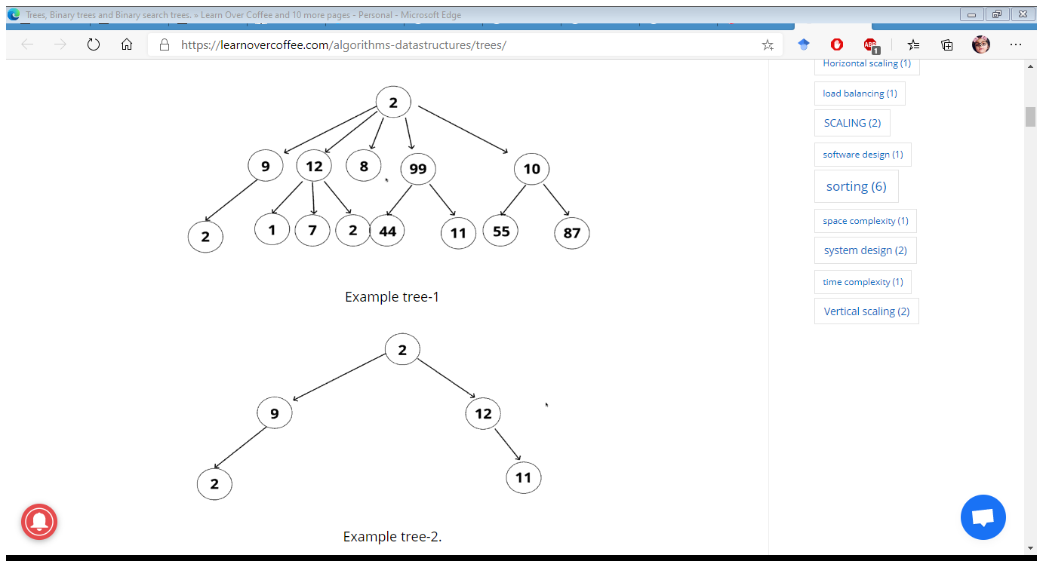
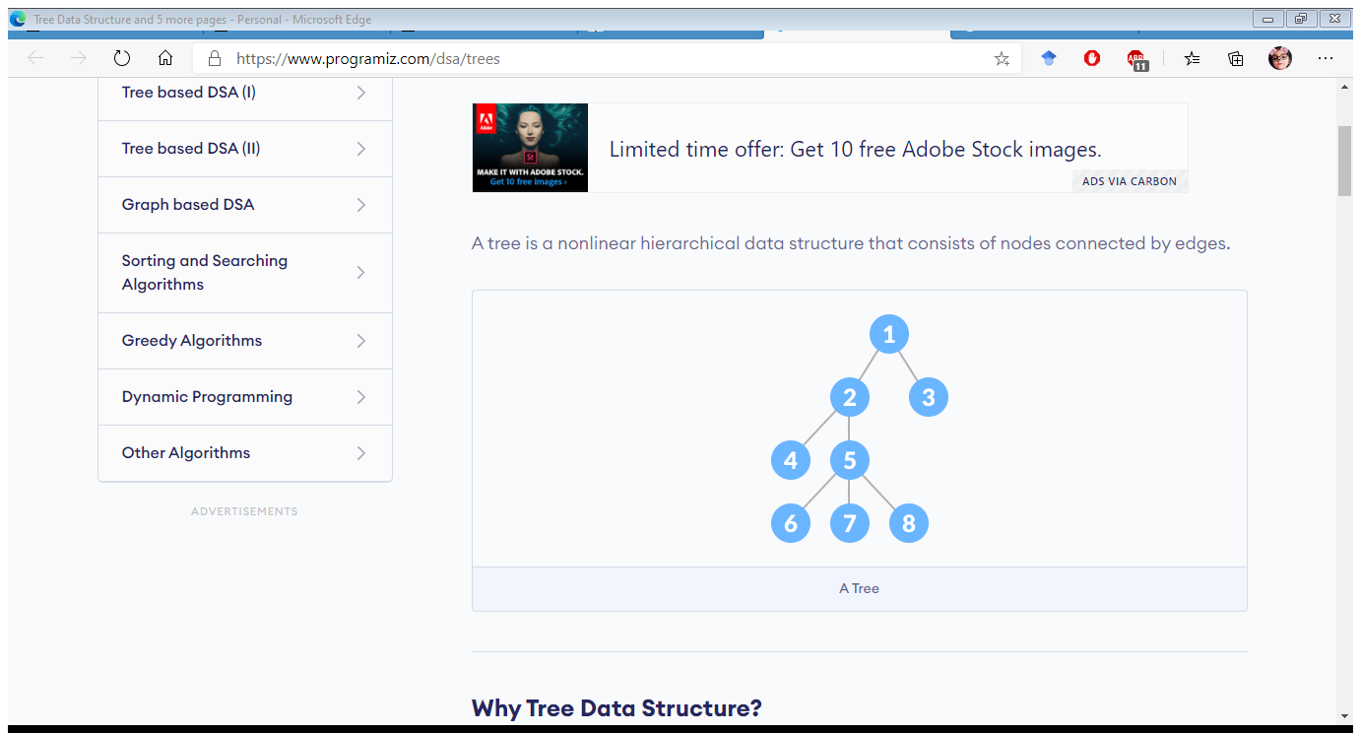
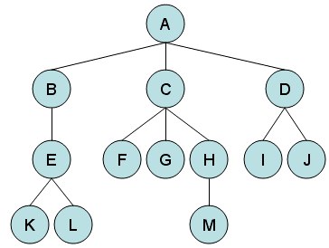
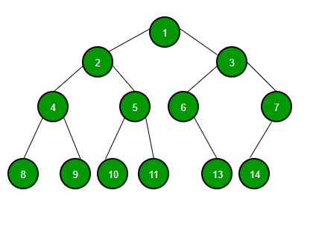
TREE – DATA STRUCTURE

Slide 4
TREE TERMINOLOGIES – DATA STRUCTURE
Node - A node is a structure that may contain a value or condition, or represent a separate data structure.
Root - The top node in a tree, the prime ancestor. Child - A node directly connected to another node when moving away from the root, an immediate descendant. Parent - The converse notion of a child, an immediate ancestor. Siblings - A group of nodes with the same parent. Neighbor - Parent or child.

Slide 5
TREE TERMINOLOGIES – DATA STRUCTURE
Descendant - A node reachable by repeated proceeding from parent to child. Also known as sub child. Ancestor - A node reachable by repeated proceeding from child to parent. Leaf / External node:- A node with no children. Branch node / Internal node - A node with at least one child. Degree - For a given node, its number of children. A leaf is necessarily degree zero. The degree of a tree is the degree of its root. The degree of a tree is The degree of the root. Edge - The connection between one node and another.
Forest - A collection of disjoint trees is called a forest.

Slide 6
TREE TERMINOLOGIES – DATA STRUCTURE
M
M is the root of this tree
G is the root of the left subtree of M
B, H, J, N and S are leaves
N is the left child of P, S is the right child
P is the parent of N
M and G are ancestors of D
P, N and S are descendants of W
Node J is at depth 2 (i.e depth = length of path from node to that node = number of edges)
Node W is at height 2 (i.e height = length of longest path from that node to leaf node)
G
W
D
J
P
B
H
N
S

Slide 7
TREE TERMINOLOGIES – DATA STRUCTURE
Path - A sequence of nodes and edges connecting a node with a descendant. Distance - The number of edges along the shortest path between two nodes. Depth - The distance between a node and the root. Height - The number of edges on the longest path between a node and a descendant leaf. Width - The number of nodes in a level. Breadth - The number of leaves. Height of tree - The height of the root node or the maximum level of any node in the tree. Sub Tree - A tree T is a tree consisting of a node in T and all of its descendants in T. Ordered Tree - A rooted tree in which ordering is specified for the children of each vertex. Size of a tree - Number of nodes in the tree.

Slide 8
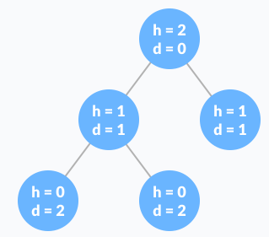
TREE TERMINOLOGIES – DATA STRUCTURE
Difference between tree height and tree depth?
The height of a node is the number of edges from
the node to the deepest leaf (i.e,. the longest path
from the node to a leaf node).
The depth of a node is the number of edges from
the root to the node.

Slide 9
Tree Traversal – DATA STRUCTURE
What is traversal?
Traversal is the facility to move through a structure, visiting each of the nodes exactly once.
Which of the following is not traversal?
1. Islamabad -> Lahore -> Faisalabad -> Karachi
2. Islamabad -> Lahore -> Faisalabad -> Islamabad -> Karachi (A repeated visit to Islamabad – not allowed)

Slide 10
Tree Traversal – DATA STRUCTURE
Pre-order Traversal
Post-order Traversal
In-order Traversal
Notion
P: Visit the parent node
L: Visit the left subtree
R: Visit the right subtree

Slide 11
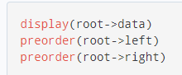
Tree Traversal – DATA STRUCTURE
Pre-order Traversal
Visit root node
Visit all the nodes in the left subtree
Visit all the nodes in the right subtree

Slide 12
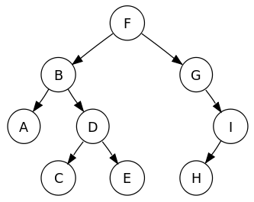
Tree Traversal – DATA STRUCTURE
Pre-order Traversal Example

Slide 13
Tree Traversal – DATA STRUCTURE
Pre-order Traversal Example
Start from the root
Output: F

Slide 14
Tree Traversal – DATA STRUCTURE
Pre-order Traversal Example
Now the root = B , display it and go to
its left subtree where root = A and
then its right subtree where root = D
Output: F, B

Slide 15
Tree Traversal – DATA STRUCTURE
Pre-order Traversal Example
Now the root = A, display it and go to
its left subtree where root = NULL and
then its right subtree where root = NULL
So we will move towards right subtree of
Node D
Output: F, B, A

Slide 16
Tree Traversal – DATA STRUCTURE
Pre-order Traversal Example
Now the root = D, display it and go to
its left subtree where root = C and
then its right subtree where root = E
Output: F, B, A, D

Slide 17
Tree Traversal – DATA STRUCTURE
Pre-order Traversal Example
Now the root = C, display it and go to
its left subtree root = NULL and then its right
subtree where root = NULL So we will move
towards right subtree of Node E
Output: F, B, A, D, C

Slide 18
Tree Traversal – DATA STRUCTURE
Pre-order Traversal Example
Now the root = E, display it and go to
its left subtree root = NULL and then its right
subtree where root = NULL So we will move
towards right subtree of Node F
Output: F, B, A, D, C, E

Slide 19
Tree Traversal – DATA STRUCTURE
Pre-order Traversal Example
Now the root = G, display it and go to
its left subtree root = NULL and then its right
subtree where root = I So we will move
towards right subtree.
Output: F, B, A, D, C, E, G

Slide 20
Tree Traversal – DATA STRUCTURE
Pre-order Traversal Example
Now the root = I, display it and go to
its left subtree root = H and then its right
subtree where root = NULL So we will move
towards left subtree.
Output: F, B, A, D, C, E, G, I

Slide 21
Tree Traversal – DATA STRUCTURE
Pre-order Traversal Example
Now the root = H, display it and go to
its left subtree root = NULL and then its right
subtree where root = NULL and there is no
more subtree left for traversal so here our
pre-order traversal will be completed.
Output: F, B, A, D, C, E, G, I, H

Slide 22
Tree Traversal – DATA STRUCTURE
Pre-order Traversal Example
TRAVERSAL COMPLETED
Output: F, B, A, D, C, E, G, I, H

Slide 23
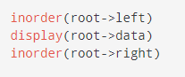
Tree Traversal – DATA STRUCTURE
In-order Traversal
First, visit all the nodes in the left subtree
Then the root node
Visit all the nodes in the right subtree

Slide 24
Tree Traversal – DATA STRUCTURE
In-order Traversal Example

Slide 25
Tree Traversal – DATA STRUCTURE
In-order Traversal Example
Start from the left most subtree
Output: A

Slide 26
Tree Traversal – DATA STRUCTURE
In-order Traversal Example
Display its parent i.e, node B
Output: A, B

Slide 27
Tree Traversal – DATA STRUCTURE
In-order Traversal Example
After displaying its parent i.e, node B
go to its right subtree i.e, node D
and go to its left subtree i.e, node
C
Output: A, B, C

Slide 28
Tree Traversal – DATA STRUCTURE
In-order Traversal Example
Display its parent i.e, node D
Output: A, B, C, D

Slide 29
Tree Traversal – DATA STRUCTURE
In-order Traversal Example
After displaying its parent i.e, node D
go to its right subtree where root = E
Output: A, B, C, D, E

Slide 30
Tree Traversal – DATA STRUCTURE
In-order Traversal Example
As there is no child of node E so
Display the parent of B and then go towards
Its left subtree because traversal of left
Subtree for root = F is completed.
Output: A, B, C, D, E, F

Slide 31
Tree Traversal – DATA STRUCTURE
In-order Traversal Example
As there is no left child of node G so
Display the right child of F and then go
towards its left subtree.
Output: A, B, C, D, E, F, G

Slide 32
Tree Traversal – DATA STRUCTURE
In-order Traversal Example
Now display the left child of I and then
go towards its left subtree.
Output: A, B, C, D, E, F, G, H

Slide 33
Tree Traversal – DATA STRUCTURE
In-order Traversal Example
Display the parent of H and go towards
its right subtree as there is no right
subtree and traversal for both left and
right subtrees of root node F is completed.
Output: A, B, C, D, E, F, G, H, I

Slide 34
Tree Traversal – DATA STRUCTURE
In-order Traversal Example
TRAVERSAL COMPLETED
Output: A, B, C, D, E, F, G, H, I

Slide 35
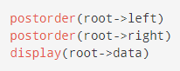
Tree Traversal – DATA STRUCTURE
Post-order Traversal
Visit all the nodes in the left subtree
Visit all the nodes in the right subtree
Visit the root node

Slide 36
Tree Traversal – DATA STRUCTURE
Post-order Traversal Example

Slide 37
Tree Traversal – DATA STRUCTURE
Post-order Traversal Example
Start from the left most node
Output: A

Slide 38
Tree Traversal – DATA STRUCTURE
Post-order Traversal Example
Now go to its right sibling i.e, node D
and then its left most node i.e, node C
Output: A, C

Slide 39
Tree Traversal – DATA STRUCTURE
Post-order Traversal Example
Now go to its right sibling i.e, node E
As it has no children so display it
And go to its parent i.e, node D
Output: A, C, E

Slide 40
Tree Traversal – DATA STRUCTURE
Post-order Traversal Example
As E has no children so display its
parent i.e, node D and go to the parent
of node D i.e, node B
Output: A, C, E, D

Slide 41
Tree Traversal – DATA STRUCTURE
Post-order Traversal Example
Now go to the parent of node D i.e, node B
Output: A, C, E, D, B

Slide 42
Tree Traversal – DATA STRUCTURE
Post-order Traversal Example
Display node B and go its right sibling i.e,
Node G as it has no left child go to
Its right child i.e, node I and towards
The left child of node I i.e,
node H display it
Output: A, C, E, D, B, H

Slide 43
Tree Traversal – DATA STRUCTURE
Post-order Traversal Example
As Node H has no right sibling so display its
Parent i.e, Node I
Output: A, C, E, D, B, H, I

Slide 44
Tree Traversal – DATA STRUCTURE
Post-order Traversal Example
Now parent of Node I i.e, Node G
Output: A, C, E, D, B, H, I, G

Slide 45
Tree Traversal – DATA STRUCTURE
Post-order Traversal Example
And at the end parent of Node G
i.e, root node F
Output: A, C, E, D, B, H, I, G, F

Slide 46
Tree Traversal – DATA STRUCTURE
Post-order Traversal Example
TRAVERSAL COMPLETED
Output: A, C, E, D, B, H, I, G, F

Slide 47
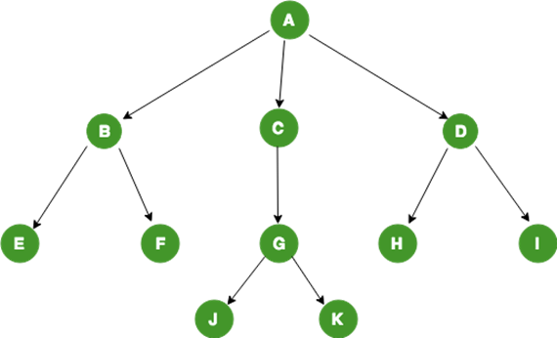
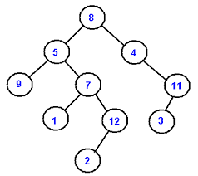
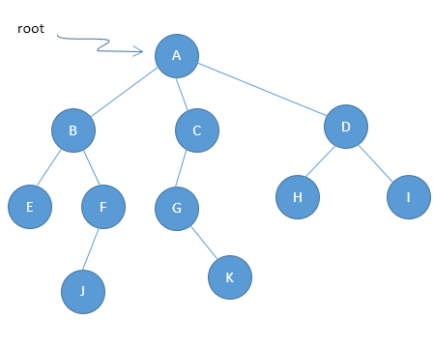
Tree Traversal – DATA STRUCTURE
Practice traversals on these trees

Slide 48
TREE TYPES – DATA STRUCTURE
Binary Tree
Binary Search Tree
AVL Tree
B-Tree

Slide 49
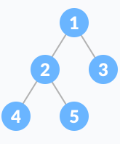
BINARY TREE – DATA STRUCTURE
A binary tree is a type of tree in which
each node has utmost 2 child nodes.
Binary Tree is a rooted tree in which
root can have maximum two children such that each of them is again a binary tree. That means, there
can be 0,1, or 2 children of any node.

Slide 50
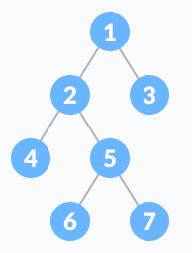
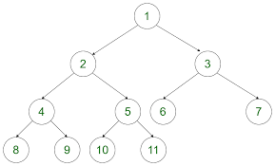
BINARY TREE – DATA STRUCTURE
Types of Binary Tree
Full Binary Tree
A full Binary tree is a special type of binary tree in which
every parent node/internal node has either two or no
children.

Slide 51
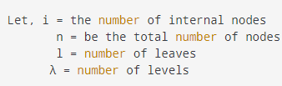
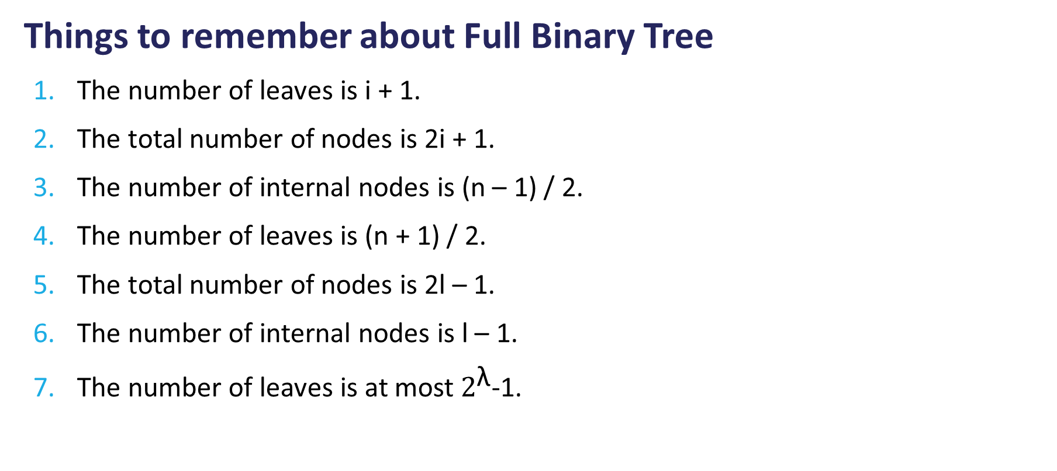
BINARY TREE – DATA STRUCTURE
Things to remember about Full Binary Tree
The number of leaves is i + 1.
The total number of nodes is 2i + 1.
The number of internal nodes is (n – 1) / 2.
The number of leaves is (n + 1) / 2.
The total number of nodes is 2l – 1.
The number of internal nodes is l – 1.
The number of leaves is at most $2^{\text{λ}}$-1.

Slide 52
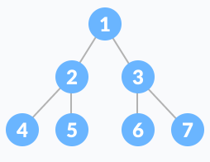
BINARY TREE – DATA STRUCTURE
Perfect Binary Tree
A perfect binary tree is a type of binary tree in which
every internal node has exactly two child nodes and
all the leaf nodes are at the same level.

Slide 53
BINARY TREE – DATA STRUCTURE
Things to remember about Perfect Binary Tree
A perfect binary tree of height h has 2h + 1 – 1 node.
A perfect binary tree with n nodes has height log(n + 1) – 1 = Θ(ln(n)).
A perfect binary tree of height h has 2h leaf nodes.
The average depth of a node in a perfect binary tree is Θ(ln(n)).

Slide 54
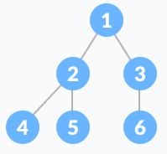
BINARY TREE – DATA STRUCTURE
Complete Binary Tree
A complete binary tree is just like a full binary tree, but with two major differences
Every level must be completely filled
All the leaf elements must lean towards the left.
The last leaf element might not have a right sibling i.e. a complete binary tree doesn't have to be a full binary tree.

Slide 55

BINARY TREE – DATA STRUCTURE
Degenerate or Pathological Tree
A degenerate or pathological tree is the tree having a single child either left or right.

Slide 56
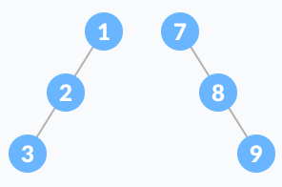
BINARY TREE – DATA STRUCTURE
Skewed Binary Tree
A skewed binary tree is a pathological/degenerate tree in which the tree is either dominated by the left nodes or the right nodes. Thus, there are two types of skewed binary tree: left-skewed binary tree and right-skewed binary tree.

Slide 57
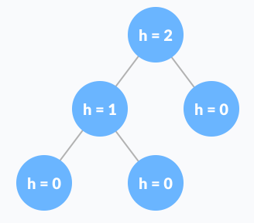
BINARY TREE – DATA STRUCTURE
Balanced Binary Tree
It is a type of binary tree in which the difference between the left and the right subtree for each node is either 0 or 1.

Slide 58
BINARY TREE – DATA STRUCTURE
Balanced Binary Tree
It is a type of binary tree in which the difference between the left and the right subtree for each node is either 0 or 1.

Slide 59
BINARY TREE – DATA STRUCTURE
Binary Tree Representation
Binary trees can be represented in two way:
Dynamic Node Representation (Linked List Representation).
Array Representation (Sequential Representation).

Slide 60
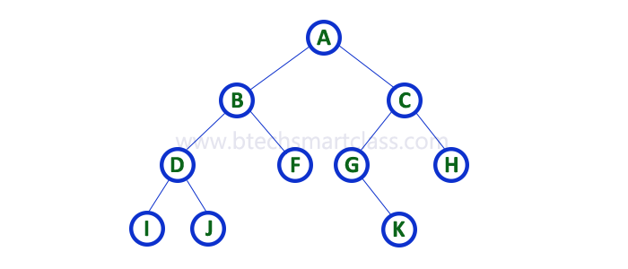
BINARY TREE – DATA STRUCTURE
Consider the following binary tree:

Slide 61
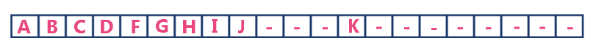
BINARY TREE – DATA STRUCTURE
Array Representation of Binary Tree
In array representation of a binary tree, we use one-dimensional array (1-D Array) to represent a binary tree.
Consider the above example of a binary tree and it is represented as follows:

Slide 62
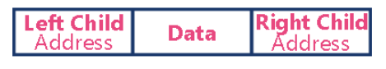
BINARY TREE – DATA STRUCTURE
Linked List Representation of Binary Tree
We use a double linked list to represent a binary tree. In a double linked list, every node consists of three fields. First field for storing left child address, second for storing actual data and third for storing right child address.
In this linked list representation, a node has the following structure.

Slide 63
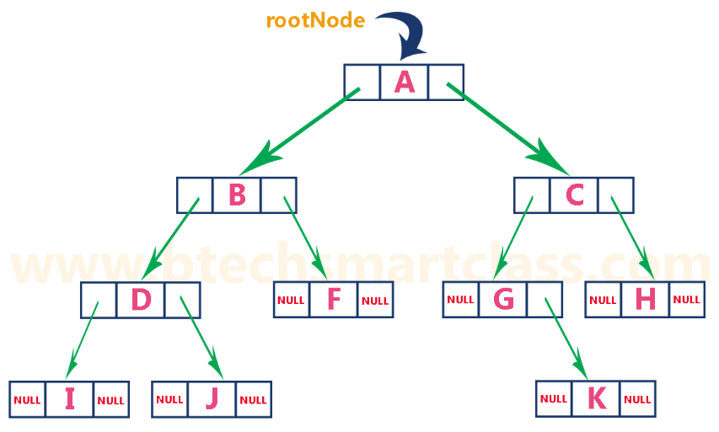
BINARY TREE – DATA STRUCTURE
Linked List
Representation of
Binary Tree
The above example of
the binary tree represented
using Linked list
representation is shown as
follows.

Slide 64
BINARY TREE – DATA STRUCTURE
Binary Tree Applications
For easy and quick access to data
In router algorithms
To implement heap data structure
Syntax tree

Slide 65
BINARY Search TREE – DATA STRUCTURE
Binary Search Tree(BST)
Binary search tree is a data structure that quickly allows us to maintain a sorted list of numbers.
It is called a binary tree because each tree node has a maximum of two children.
It is called a search tree because it can be used to search for the presence of a number in O(log(n)) time.
The properties that separate a binary search tree from a regular binary tree is
All nodes of left subtree are less than the root node
All nodes of right subtree are more than the root node
Both subtrees of each node are also BSTs i.e. they have the above two properties

Slide 66
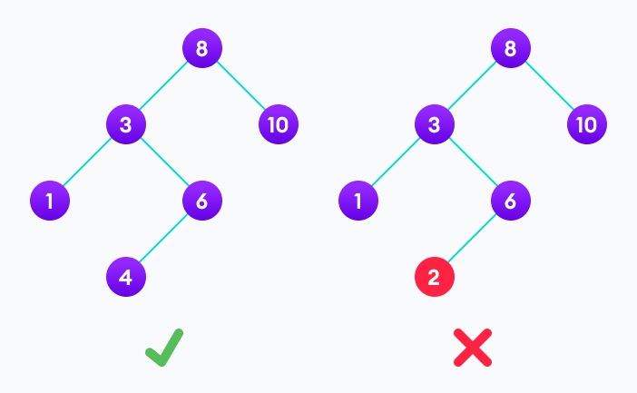
BINARY search TREE – DATA STRUCTURE
A tree having a right subtree with one value smaller than the root is shown to demonstrate that it is not a valid binary search tree
The binary tree on the right isn't a binary search tree because the right subtree of the node "3" contains a value smaller than it.

Slide 67
BINARY SEARCH TREE – DATA STRUCTURE
There are two basic operations that you can perform on a binary search tree:
Search Operation
The algorithm depends on the property of BST that if each left subtree has values below root and each right subtree has values above the root.
If the value is below the root, we can say for sure that the value is not in the right subtree; we need to only search in the left subtree and if the value is above the root, we can say for sure that the value is not in the left subtree; we need to only search in the right subtree.

Slide 68
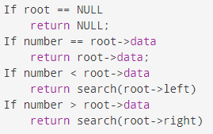
BINARY SEARCH TREE – DATA STRUCTURE
Algorithm:

Slide 69
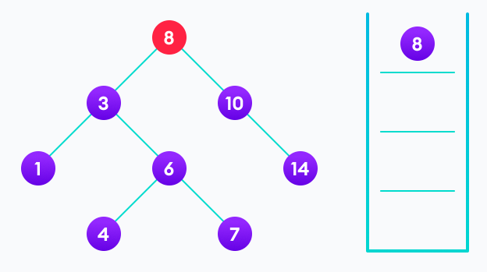
BINARY SEARCH TREE – DATA STRUCTURE
Let us try to visualize this with a diagram.
4 is not found so, traverse through the left subtree of 8

Slide 70
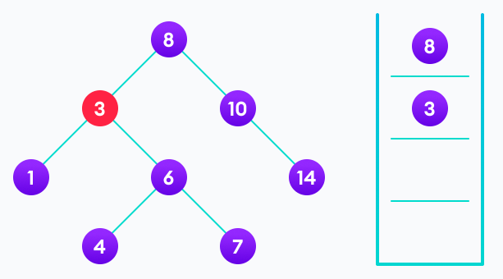
BINARY SEARCH TREE – DATA STRUCTURE
4 is not found so, traverse through the right subtree of 3

Slide 71
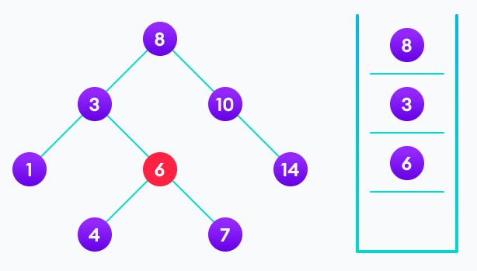
BINARY SEARCH TREE – DATA STRUCTURE
4 is not found so, traverse through the left subtree of 6

Slide 72
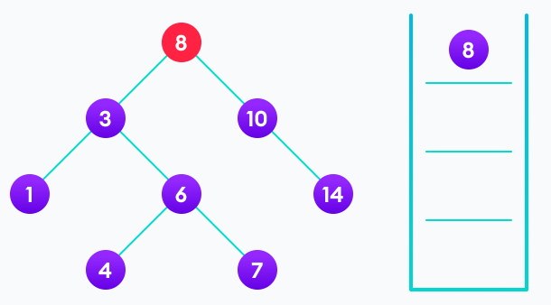
BINARY SEARCH TREE – DATA STRUCTURE
4 is found

Slide 73
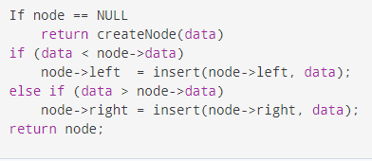
BINARY SEARCH TREE – DATA STRUCTURE
Insert Operation
nserting a value in the correct position is similar to searching because we try to maintain the rule that the left subtree is lesser than root and the right subtree is larger than root.
We keep going to either right subtree or left subtree depending on the value and when we reach a point left or right subtree is null, we put the new node there.
Algorithm

Slide 74
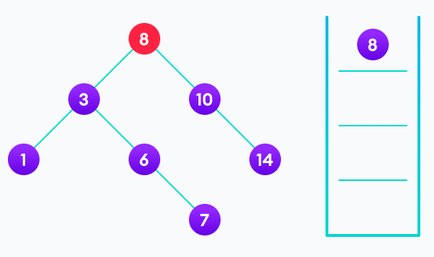
BINARY SEARCH TREE – DATA STRUCTURE
Let us try to visualize this with a diagram.
4<8 so, transverse through the left child of 8

Slide 75
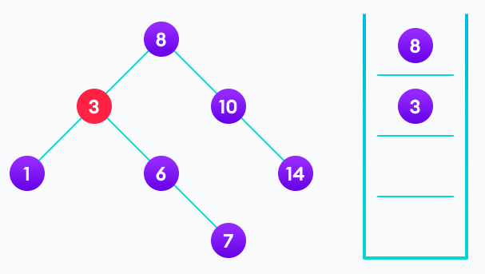
BINARY SEARCH TREE – DATA STRUCTURE
Let us try to visualize this with a diagram.
4>3 so, transverse through the right child of 8

Slide 76
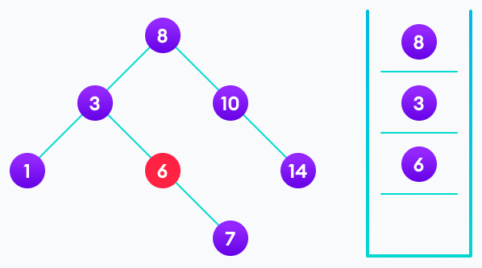
BINARY SEARCH TREE – DATA STRUCTURE
Let us try to visualize this with a diagram.
4<6 so, transverse through the left child of 6

Slide 77
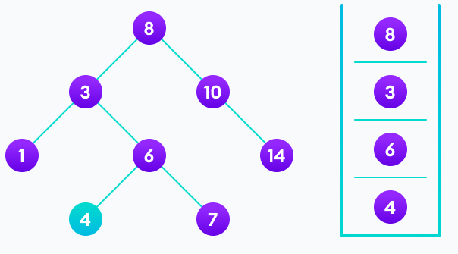
BINARY SEARCH TREE – DATA STRUCTURE
Let us try to visualize this with a diagram.
Insert 4 as a left child of 6

Slide 78
BINARY SEARCH TREE – DATA STRUCTURE
At the end …
We have attached the node but we still have to exit from the function without doing any damage to the rest of the tree. This is where the return node; at the end comes in handy. In the case of NULL, the newly created node is returned and attached to the parent node, otherwise the same node is returned without any change as we go up until we return to the root.
This makes sure that as we move back up the tree, the other node connections aren't changed.

Slide 79
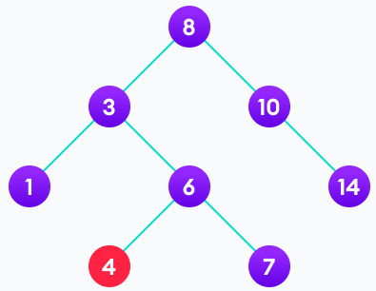
BINARY SEARCH TREE – DATA STRUCTURE
Deletion Operation
There are three cases for deleting a node from a binary search tree.
Case I
In the first case, the node to be deleted is the leaf
node. In such a case, simply delete the node from
the tree.
4 is to be deleted

Slide 80
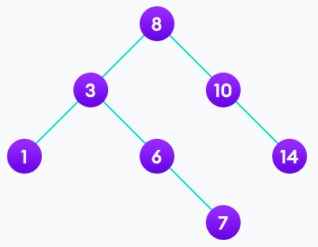
BINARY SEARCH TREE – DATA STRUCTURE
Deletion Operation
There are three cases for deleting a node from a binary search tree.
Case I
In the first case, the node to be deleted is the leaf
node. In such a case, simply delete the node from
the tree.
4 is deleted

Slide 81
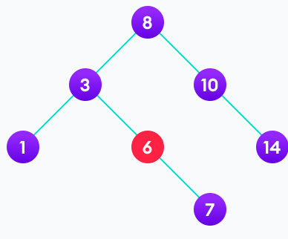
BINARY SEARCH TREE – DATA STRUCTURE
Case II
In the second case, the node to be deleted lies has a single child node. In such a case follow the steps below:
Replace that node with its child node.
Remove the child node from its original position.
6 is to be deleted

Slide 82
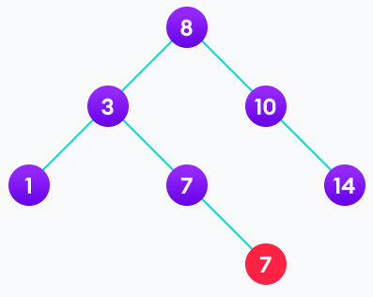
BINARY SEARCH TREE – DATA STRUCTURE
Case II
In the second case, the node to be deleted lies has a single child node. In such a case follow the steps below:
Replace that node with its child node.
Remove the child node from its original position.
copy the value of its child to the node and delete
the child.

Slide 83
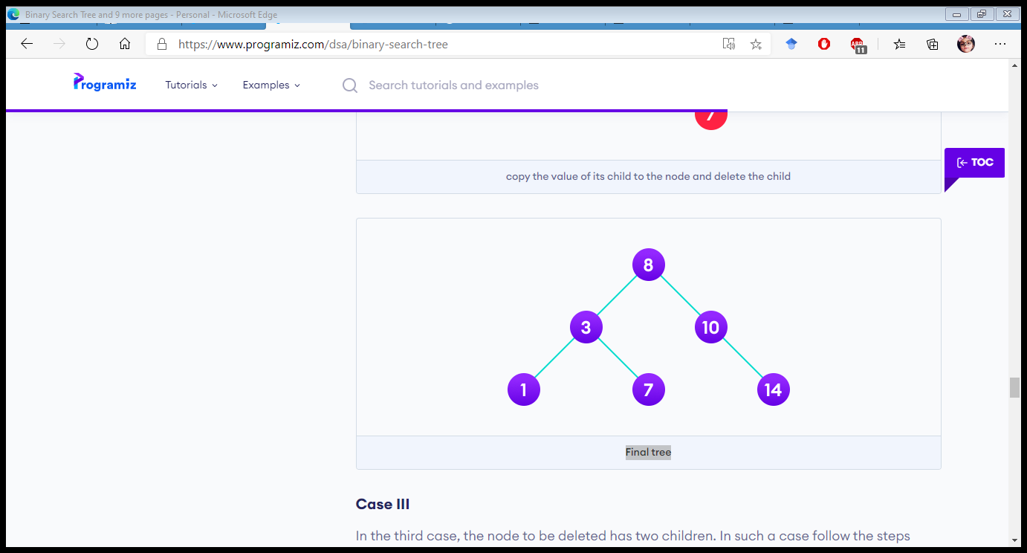
BINARY SEARCH TREE – DATA STRUCTURE
Case II
In the second case, the node to be deleted lies has a single child node. In such a case follow the steps below:
Replace that node with its child node.
Remove the child node from its original
position.
Final Tree.

Slide 84
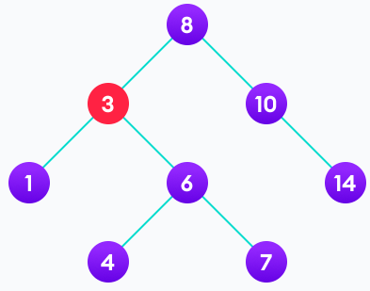
BINARY SEARCH TREE – DATA STRUCTURE
Case III
In the third case, the node to be deleted has two children. In such a case follow the steps below:
Get the inorder successor of that node.
Replace the node with the inorder
successor.
Remove the inorder successor from its
original position.
3 is to be deleted

Slide 85
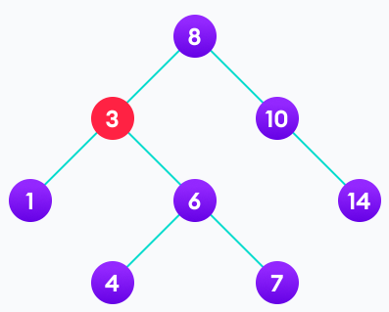
BINARY SEARCH TREE – DATA STRUCTURE
Case III
In the third case, the node to be deleted has two children. In such a case follow the steps below:
Get the inorder successor of that node.
Replace the node with the inorder
successor.
Remove the inorder successor from its
original position.
Copy the value of the inorder successor (4) to
the node

Slide 86
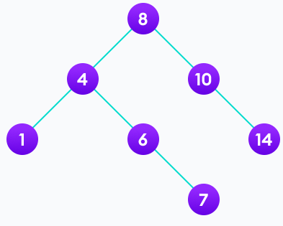
BINARY SEARCH TREE – DATA STRUCTURE
Case III
In the third case, the node to be deleted has two children. In such a case follow the steps below:
Get the inorder successor of that node.
Replace the node with the inorder
successor.
Remove the inorder successor from its
original position.
Delete the inorder successor

Slide 87
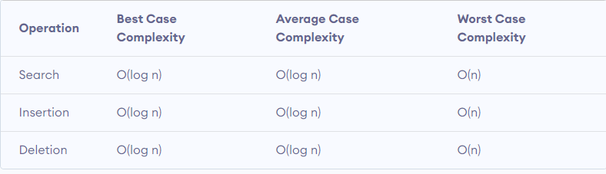
BINARY SEARCH TREE – DATA STRUCTURE
Binary Search Tree Complexities
Time Complexity
Here, n is the number of nodes in the tree.

Slide 88
BINARY SEARCH TREE – DATA STRUCTURE
Binary Search Tree Complexities
Space Complexity
The space complexity for all the operations is O(n).

Slide 89
BINARY SEARCH TREE – DATA STRUCTURE
Binary Search Tree Applications
In multilevel indexing in the database
For dynamic sorting
For managing virtual memory areas in Unix kernel

Slide 90
AVL TREE – DATA STRUCTURE
AVL tree is a self-balancing binary search tree in which each node maintains extra information called a balance factor whose value is either -1, 0 or +1.
AVL tree got its name after its inventor Georgy Adelson-Velsky and Landis.
Balance Factor
Balance factor of a node in an AVL tree is the difference between the height of the left subtree and that of the right subtree of that node.
Balance Factor = (Height of Left Subtree - Height of Right Subtree) or (Height of Right Subtree - Height of Left Subtree)
The self balancing property of an avl tree is maintained by the balance factor. The value of balance factor should always be -1, 0 or +1.

Slide 91
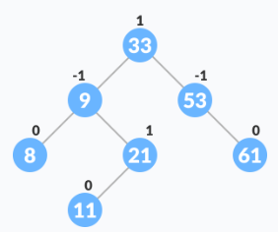
AVL TREE – DATA STRUCTURE
An example of a balanced AVL tree is:

Slide 92
AVL TREE – DATA STRUCTURE
Operations on an AVL tree
Various operations that can be performed on an AVL tree are:
Rotating the subtrees in an AVL Tree
In rotation operation, the positions of the nodes of a subtree are interchanged.
There are two types of rotations:
Left Rotate
In left-rotation, the arrangement of the nodes on the right is transformed into the arrangements on the left node.

Slide 93
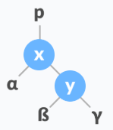
AVL TREE – DATA STRUCTURE
Algorithm:
Let the initial tree be:
Left rotate

Slide 94
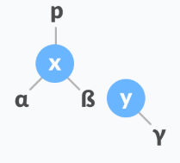
AVL TREE – DATA STRUCTURE
Algorithm:
If y has a left subtree, assign x as the parent of the left subtree of y.
Assign x as the parent of the left subtree of y

Slide 95
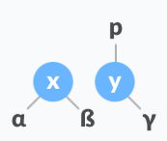
AVL TREE – DATA STRUCTURE
Algorithm:
If the parent of x is NULL, make y as the root of the tree.
Else if x is the left child of p, make y as the left child of p.
Else assign y as the right child of p.
Make y as the parent of x

Slide 96

AVL TREE – DATA STRUCTURE
Algorithm:
If the parent of x is NULL, make y as the root of the tree.
Else if x is the left child of p, make y as the left child of p.
Else assign y as the right child of p.
Assign y as the parent of x.

Slide 97

AVL TREE – DATA STRUCTURE
Algorithm:
In left-rotation, the arrangement of the nodes on the left is transformed into the arrangements on the right node.
Let the initial tree be:
Right rotate

Slide 98
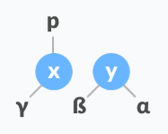
AVL TREE – DATA STRUCTURE
Algorithm:
If x has a right subtree, assign y as the parent of the right subtree of x.
Assign the parent of y as the parent of x.

Slide 99
AVL TREE – DATA STRUCTURE
Algorithm:
If the parent of y is NULL, make x as the root of the tree.
Else if y is the right child of its parent p, make x as the right child of p.
Else assign x as the left child of p.
Assign the parent of y as the parent of x.

Slide 100

AVL TREE – DATA STRUCTURE
Algorithm:
Make x as the parent of y.
Assign x as the parent of y.

Slide 101

AVL TREE – DATA STRUCTURE
Algorithm:
In left-right rotation, the arrangements are first shifted to the left and then to the right.
Do left rotation on x-y.
Left rotate x-y

Slide 102

AVL TREE – DATA STRUCTURE
Algorithm:
Do right rotation on y-z.
Right rotate z-y

Slide 103

AVL TREE – DATA STRUCTURE
Algorithm:
In left-right rotation, the arrangements are first shifted to the right and then to the left.
Do right rotation on x-y.
Right rotate x-y

Slide 104

AVL TREE – DATA STRUCTURE
Algorithm:
In left-right rotation, the arrangements are first shifted to the right and then to the left.
Do left rotation on z-y.
Left rotate z-y

Slide 105

AVL TREE – DATA STRUCTURE
Algorithm to insert a newNode
A newNode is always inserted as a leaf node with balance factor equal to 0.
Let the initial tree be:

Slide 106

AVL TREE – DATA STRUCTURE
Let the node to be inserted be:
Go to the appropriate leaf node to insert a newNode using the following recursive steps. Compare newKey with rootKey of the current tree.
If newKey < rootKey, call insertion algorithm on the left subtree of the current node until the leaf node is reached.
Else if newKey > rootKey, call insertion algorithm on the right subtree of current node until the leaf node is reached.
Else, return leafNode.

Slide 107

AVL TREE – DATA STRUCTURE

Slide 108

AVL TREE – DATA STRUCTURE
Compare leafKey obtained from the above steps with newKey:
If newKey < leafKey, make newNode as the leftChild of leafNode.
Else, make newNode as rightChild
of leafNode.

Slide 109

AVL TREE – DATA STRUCTURE
Update balanceFactor of the nodes.

Slide 110

AVL TREE – DATA STRUCTURE
If the nodes are unbalanced, then rebalance the node.
If balanceFactor > 1, it means the height of the left subtree is greater than that of the right subtree. So, do a right rotation or left-right rotation
If newNodeKey < leftChildKey do right rotation.
Else, do left-right rotation.

Slide 111

AVL TREE – DATA STRUCTURE
If the nodes are unbalanced, then rebalance the node.
If balanceFactor > 1, it means the height of the left subtree is greater than that of the right subtree. So, do a right rotation or left-right rotation
If newNodeKey < leftChildKey do right rotation.
Else, do left-right rotation.

Slide 112

AVL TREE – DATA STRUCTURE
If balanceFactor < -1, it means the height of the right subtree is greater than that of the left subtree. So, do right rotation or right-left rotation
If newNodeKey > rightChildKey do left rotation.
Else, do right-left rotation
The final tree is:
Final balanced tree

Slide 113

AVL TREE – DATA STRUCTURE
Algorithm to Delete a node
A node is always deleted as a leaf node. After deleting a node, the balance factors of the nodes get changed. In order to rebalance the balance factor, suitable rotations are performed.
Locate nodeToBeDeleted

Slide 114
AVL TREE – DATA STRUCTURE
There are three cases for deleting a node:
If nodeToBeDeleted is the leaf node (ie. does not have any child), then remove nodeToBeDeleted.
If nodeToBeDeleted has one child, then substitute the contents of nodeToBeDeleted with that of the child. Remove the child.
If nodeToBeDeleted has two children, find the inorder successor w of nodeToBeDeleted (ie. node with a minimum value of key in the right subtree).

Slide 115

AVL TREE – DATA STRUCTURE

Slide 116

AVL TREE – DATA STRUCTURE
Substitute the contents of nodeToBeDeleted with that of w.

Slide 117

AVL TREE – DATA STRUCTURE
Remove the leaf node w.

Slide 118

AVL TREE – DATA STRUCTURE
Update balanceFactor of the nodes.

Slide 119

AVL TREE – DATA STRUCTURE
Rebalance the tree if the balance factor of any of the nodes is not equal to -1, 0 or 1.
If balanceFactor of currentNode > 1,
If balanceFactor of leftChild >= 0, do right rotation.

Slide 120

AVL TREE – DATA STRUCTURE
Else do left-right rotation.
If balanceFactor of currentNode < -1,
If balanceFactor of rightChild <= 0, do left rotation.
Else do right-left rotation.
The final tree is:

Slide 121

AVL TREE – DATA STRUCTURE
Complexities of Different Operations on an AVL Tree
AVL Tree Applications
For indexing large records in databases
For searching in large databases

Slide 122

TREE TRAVERSAL – DATA STRUCTURE

Slide 123
TREE TRAVERSAL – DATA STRUCTURE
Traversing a linear data structure is very simple as there are no child nodes for each node. But in the case of non-linear data structures such as a tree, there are child nodes. Thus traversing them makes a little complex and confusing. Let’s discuss various possible ways to traverse a tree.
There are different ways to traverse a tree. They are
Breadth-first search(BFS).
Depth-first search(DFS).

Slide 124

Breadth first TRAVERSAL – DATA STRUCTURE
Breadth-First Search
In the example, there are three levels.
Firstly the root value 10 is read. In the next
level, the values 6,2 are read. Similarly from
level 3, all the values 3,8,20 are read.

Slide 125

Breadth first TRAVERSAL – DATA STRUCTURE

Slide 126
DEPTH first TRAVERSAL – DATA STRUCTURE
Depth-First Search
Unlike the breadth-first search, the Depth-first search algorithm reads all the values formed by the child node and its child nodes before going to another direct child node. By observing the reading structure looks like reading the deepest node values. So it is called the depth-first search.
Based on the order of traversing a node it’s further divided into 3 types.
Death-First in order search.
Depth-first pre-order search.
Depth-first post-order search.

Slide 127
DEPTH first TRAVERSAL – DATA STRUCTURE
Depth-First Search
Unlike the breadth-first search, the Depth-first search algorithm reads all the values formed by the child node and its child nodes before going to another direct child node. By observing the reading structure looks like reading the deepest node values. So it is called the depth-first search.
Based on the order of traversing a node it’s further divided into 3 types.
Death-First in order search.
Depth-first pre-order search.
Depth-first post-order search.

Slide 128

SPANNING TREE – DATA STRUCTURE
A spanning tree is a sub-graph of an undirected and a connected graph, which includes all the vertices of the graph having a minimum possible number of edges. If a vertex is missed, then it is not a spanning tree.
The edges may or may not have weights assigned to them.
The total number of spanning trees with n vertices that can be created from a complete graph is equal to $n^{n−2}$
If we have n = 4, the maximum number of possible spanning trees is equal to $4^{4−2}$= $4^{2}$ = 16. Thus, 16 spanning trees can be formed from a complete graph with 4 vertices.

Slide 129

SPANNING TREE – DATA STRUCTURE
Removing one edge from spanning tree will make it disconnected
Adding one edge to spanning tree will make a loop
If each edge has distinct weight then there will be only one and unique minimum spanning tree
A complete undirected graph can have $n^{n−2}$ number of spanning trees
Every connected and undirected graph has at least one spanning tree
Disconnected graph doesn't have any spanning tree
From a complete graph by removing max(e-n+1) edges we can construct a spanning tree

Slide 130

SPANNING TREE – DATA STRUCTURE
Example of a Spanning Tree
Let's understand the spanning tree with examples below:
Let the original graph be:

Slide 131




SPANNING TREE – DATA STRUCTURE
Possible Spanning Trees

Slide 132

SPANNING TREE – DATA STRUCTURE
Minimum Spanning Tree
A minimum spanning tree is a spanning tree in which the sum of the weight of the edges is as minimum as possible.
Example of a Spanning Tree
Let's understand the above definition with the help of the example below.
The initial graph is:

Slide 133



SPANNING TREE – DATA STRUCTURE
The possible spanning trees from the above graph are:
The minimum spanning tree from these
spanning trees is:

Slide 134
SPANNING TREE – DATA STRUCTURE
The minimum spanning tree from a graph is found using the following algorithms:
Prim's Algorithm
Kruskal's Algorithm
Spanning Tree Applications
Computer Network Routing Protocol
Cluster Analysis
Civil Network Planning

Slide 135
SPANNING TREE – DATA STRUCTURE
Minimum Spanning tree Applications
To find paths in the map
To design networks like telecommunication networks, water supply networks, and electrical grids.

Slide 136
SPANNING TREE – DATA STRUCTURE
Prim's Algorithm
Prim's algorithm is a minimum spanning tree algorithm that takes a graph as input and finds the subset of the edges of that graph which
form a tree that includes every vertex
has the minimum sum of weights among all the trees that can be formed from the graph

Slide 137
SPANNING TREE – DATA STRUCTURE
How Prim's algorithm works
It falls under a class of algorithms called greedy algorithms that find the local optimum in the hopes of finding a global optimum.
We start from one vertex and keep adding edges with the lowest weight until we reach our goal.
The steps for implementing Prim's algorithm are as follows:
Initialize the minimum spanning tree with a vertex chosen at random.
Find all the edges that connect the tree to new vertices, find the minimum and add it to the tree
Keep repeating step 2 until we get a minimum spanning tree

Slide 138

SPANNING TREE – DATA STRUCTURE

Slide 139

SPANNING TREE – DATA STRUCTURE

Slide 140

SPANNING TREE – DATA STRUCTURE

Slide 141

SPANNING TREE – DATA STRUCTURE

Slide 142
SPANNING TREE – DATA STRUCTURE

Slide 143

SPANNING TREE – DATA STRUCTURE

Slide 144

SPANNING TREE – DATA STRUCTURE

Slide 145

SPANNING TREE – DATA STRUCTURE

Slide 146

SPANNING TREE – DATA STRUCTURE
Practice Question:
Find a Minimum cost Spanning Tree
for this graph

Slide 147
SPANNING TREE – DATA STRUCTURE
Prim's Algorithm Complexity
The time complexity of Prim's algorithm is O(E log V).
Prim's Algorithm Application
Laying cables of electrical wiring
In network designed
To make protocols in network cycles

